Slide 1
Lecture 5: Hash Functions and Message Authentication -Cryptographic Algorithms and Protocols
Huang, Xiujie (黄秀姐)
Office: Nanhai Building, #411
E-mail: t_xiujie@jnu.edu.cn
Dept. Computer Science

Slide 2
Birthday Problems 1
There are N persons. What is the smallest N to grantee that the probability of the event that at least one person shares your birthday is greater than ½ (在N个人中，如果要保证至少有一人与你同一天生日的概率大于二分之一，那么N至少是多少)? （excluding the date of Feb., 29th ）
Answer: N=253

Slide 3
Birthday Problems 2
There are N persons. What is the smallest N to grantee that the probability of the event that at least two persons share a birthday is greater than ½ (在N个人中，如果要保证至少两人在同一天生日的概率大于二分之一，那么N至少是多少)? （excluding the date of Feb., 29th ）
Answer: N=23

Slide 4
Birthday Problems 2
the number of persons
the probability of the event that at least two persons share a birthday

Slide 5
Outline
1. Hash Functions and Data Integrity
2. Security of Hash Functions
Security based on three difficult problems
The Random Oracle Model and Algorithms in the ROM
3. Iterated Hash Functions
The Merkle-Damgard Construction & SHA-1
4. The Sponge Construction: SHA-3
5. Message Authentication Codes (MAC)
HMAC & CBC-MAC
Authenticated Encryption
6. Unconditionally Secure MAC

Slide 6

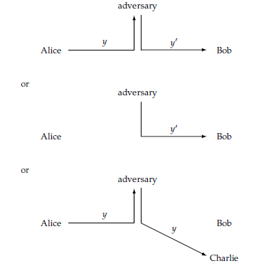
Why use Hash Functions?
A solution to prevent Passive Attack
Encryptions
A solution to prevent Active Attack
Cryptographic Hash
data integrity: To detect modifications of message
verification of the owner of the data

Slide 7
Introduction to Hash Functions
A Hash function: y=h(x)
Let x be some data, which could be a binary string of arbitrary length;
y is often called a short “fingerprint” of data x, is referred to as a message digest, would typically be a short binary string (common choices: 160 bits or 256 bits);
x is called a preimage of hash value y.
It is a one-way function: h(x) can be computed “easily” for ANY data x
y changes as x changes (even only one bit)
Image
|
Preimage
|

Slide 8
Two types of Hash Functions
A unkeyed hash function: y=h(x)
A single, fixed hash function;
the message digest y must be securely stored, but the data x is not.
A keyed hash function:
A hash function determined by a secrete key K, say y=h_{K}(x);
It is often used as a Message Authentication Code (MAC): x is message, y is the (authentication) tag
(x,y) can be transmitted over an insecure channel

Slide 9
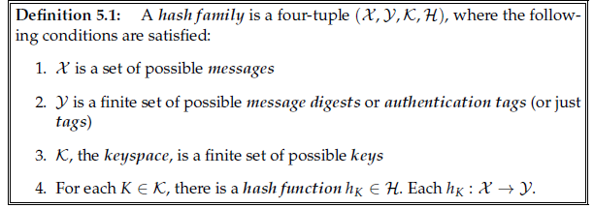



A Keyed Hash Family
If is finite, h is called a compression function; usually assume or
A valid pair (x, y):
---- It can be finite or infinite!!!

Slide 10
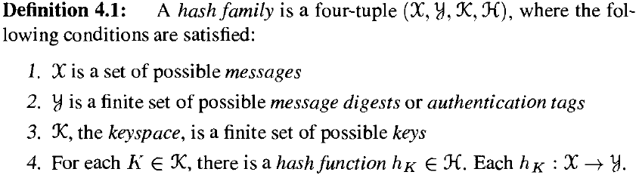

An unkeyed Hash Family
Definitions for an unkeyed hash family
If the keyspace in Definition 5.1 has only one key, then an unkeyed hash function is defined.
{ } where:

Slide 11
Applications of Hash Functions
Applications of Hash functions:
It can provide assurance of data integrity
Even if the data is stored in an insecure place
It can be used in Digital Signatures
It can be used in Password Storages

Slide 12
An Application of Hash Functions
Integrity!!
A large document finished yesterday
Today’s large document
Computer in OFFICE
Did it be tampered?
Hash
Hash
A digest generated yesterday
Are they same?
A digest generated today
A USB Memory

Slide 13
Outline
1. Hash Functions and Data Integrity
2. Security of Hash Functions
Security based on three difficult problems
The Random Oracle Model and Algorithms in the ROM
3. Iterated Hash Functions
The Merkle-Damgard Construction & SHA-1
4. The Sponge Construction: SHA-3
5. Message Authentication Codes (MAC)
HMAC & CBC-MAC
Authenticated Encryption
6. Unconditionally Secure MAC

Slide 14
2. Security of Hash Functions
Unkeyed hash function:
h: X → Y; y=h(x)
A SECURE hash function: the three basic problems are infeasible to be solved:
Preimage
Second Preimage
Collision

Slide 15
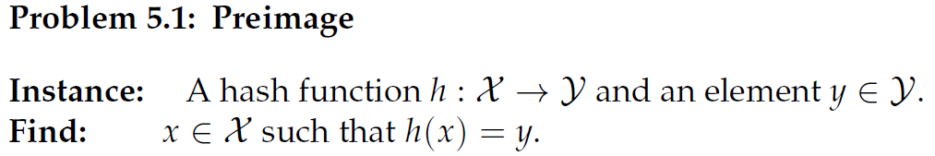
2.1 Three Basic Problems
1. Preimage
A hash function is said to be one-way or preimage resistant (单向的), if the problem Preimage cannot be efficiently solved.

Slide 16
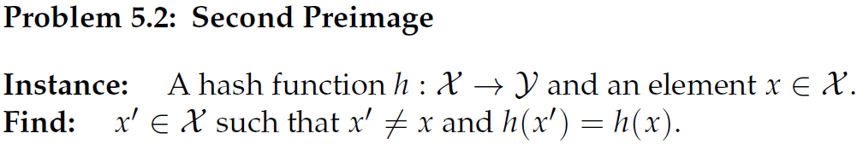
2.1 Three Basic Problems
2. Second Preimage
A hash function is said to be second preimage resistant (抗第二原像的或抗弱碰撞性的), if the problem Second Preimage cannot be efficiently solved.

Slide 17
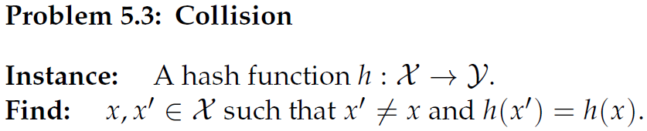
2.1 Three Basic Problems
3. Collision
A hash function is said to be collision resistant（抗强碰撞性的）, if the problem Collision cannot be efficiently solved.
If A hash function is to be considered SECURE, it should be the case that the above three problems are difficult to solve.

Slide 18
An “ideal” hash function
The only way (one-way) to produce a valid pair (x, y) is:
first choose x,
and then compute y=h(x) by applying the function h to x.
even if many other values h(x₁), h(x₂), … are known.
An Counter-Example:
h(x,y) = ax+by (mod n), linear function is not a good design for hash

Slide 19
2.2 The Random Oracle Model (随机预言模型)
It provides a mathematical model of an “ideal” hash function.
introduced by Bellare and Rogaway
h is chosen randomly from , and we are only permitted oracle to access to the function h:
no formula or algorithm is shown to us to compute values of h(x)
the only way to compute h(x) is to query the oracle
The random oracle does not exist in real life.
It is helpful for the study of the security of the hash function
ORACLE
Notes:
This can be thought of as looking up the value hx in a giant book of random numbers such that, for each possible x, there is a completely random value hx.
The true random oracle does not exist in real life; A well-designed hash function behave like a random oracle;
It is helpful for the study of the security of the hash function

Slide 20

2.2 The Random Oracle Model
The Independence Property:

Slide 21
2.3 Algorithms in the Random Oracle Model
Randomized algorithm: make random choices during execution
A Las Vegas algorithm: may fail, but if it returns an answer, then the answer must be correct.
Basic concepts:
Worst-case success probability : if for every problem instance, the algorithm returns a correct answer with prob. at least .
Average-case success probability : if the prob. that the algorithm returns a correct answer, averaged over all problem instances of a specified size is .
( , Q)-algorithm:
a Las Vegas one, average-case success prob. , query h-oracle at most Q times,
averaged over all possible h, and all possible x or y (if specified)

Slide 22
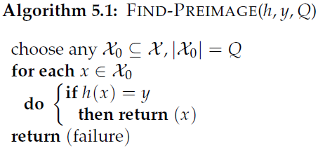
2.3 Algorithms in the Random Oracle Model
1. Find a Preimage:
≈ Q/M, if Q is very small compared to M
Notes:
Binomial expression of (a+b)^n

Slide 23
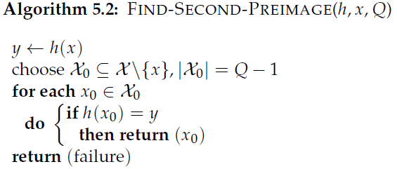
2.3 Algorithms in the Random Oracle Model
2. Find a Second Preimage:
≈ (Q-1)/M, if Q is very small compared to M

Slide 24
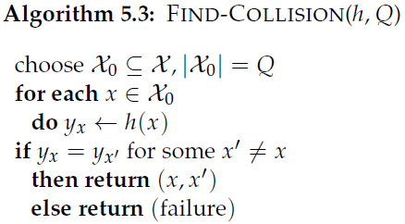
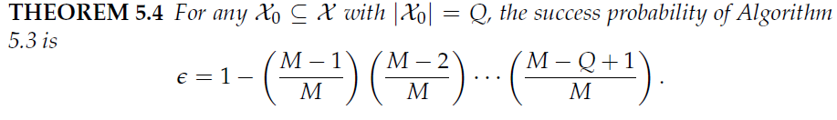
2.3 Algorithms in the Random Oracle Model
3. Find a Collision:
Theorem 5.4’: The success prob. of finding a collision is
≈ 1 – exp{-Q(Q-1)/(2M)}, if Q is very small compared to M.

Slide 25
2.3 Algorithms in the Random Oracle Model
3. Find a Collision:
(1/2, O( ))-algorithm
The success prob. of finding a collision is
≈ 1 – exp{-Q(Q-1)/(2M)}
If = 0.5, then

Slide 26
Birthday Problem 2: to find a collision
2.3 Algorithms in the Random Oracle Model
There are N persons. What is the smallest N to grantee that the probability of the event that at least two persons share a birthday is greater than ½ (在N个人中，如果要保证至少两人在同一天生日的概率大于二分之一，那么N至少是多少)? （excluding the date of Feb., 29th ）
Answer: N=23
y = h(x), P{(x₁, x₂): x₁ ≠ x₂ & h(x₁) = h(x₂)}≥ ½
a collision is found with prob. ≥ ½
If = 0.5, then ; if M = 365, Q ≈ 22.3.

Slide 27
2.3 Algorithms in the Random Oracle Model
The birthday attack (to find a collision ):
(1/2, O( ))-algorithm
imposes a lower bound on the sizes of secure message digest.
For a message digest with log₂M bits, a collision could be found with prob. ½ within 2^{0.5log2M} random hashes.
SHA-1: 160-bit message digest, the birthday attack requires over 2⁸⁰ hashes
SHA-3: message digests of length as 224~512bits

Slide 28
2.4 Comparison of Security Criteria
Method of Reduction
A reduction from a problem Π₂ to another problem Π₁ (Π₂ ∝ Π₁)
Design SolveΠ₂ by using SolveΠ₁ (Slove Π₁ serves as an ORACLE)
Solving Π₂ is no more difficult than solving Π₁
If it is infeasible to solve Π₂ , then it is infeasible to solve Π₁
Solving Collision is easier than solving Preimage
Solving Collision is easier than solving Second Preimage

Slide 29
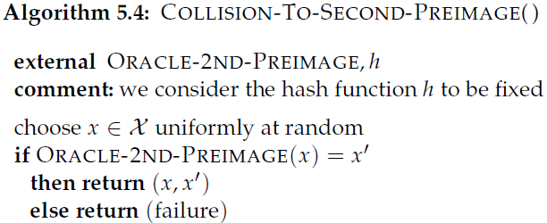
2.4 Comparison of Security Criteria
Solving Collision is easier than solving Second Preimage
Reduction from Collision to Second Preimage:
-----( , Q)-algorithm
-----( , Q)-algorithm
If a hash function is collision resistant, then it is second preimage resistant.

Slide 30
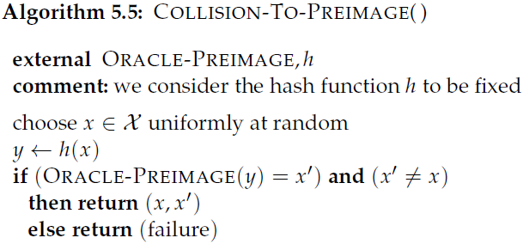
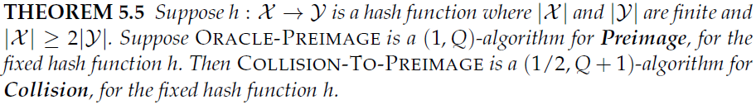
2.4 Comparison of Security Criteria
Solving Collision is easier than solving Preimage
Happens at least in some special cases
Reduction from Collision to Preimage
-------(1/2, Q+1)-algorithm
------- (1, Q)-algorithm
For some special cases, if a hash function is collision resistant, then it is preimage resistant.

Slide 31







2.4 Comparison of Security Criteria
Outline of Proof of Theorem 5.5: To compute the average-case success probability
Define equivalence relation ~: for any x, define x ~ x₁ if h(x) = h(x₁), and the equivalence class [x] = {x₁: x~x₁}.
For each class, there exists a unique y such that [x] = h⁻¹(y). ORACLE-PREIMAGE is assumed to be able to find a preimage of any y. Hence # of [x] = |Y|. Denote the set of these |Y| equivalence classes by C.
For any x randomly chosen by COLLISION-TO-PREIMAGE, there are |[x]|-1 of x₁’s in the class [x] that could yield a collision. So, the success prob. of obtaining a collision is (|[x]|-1 )/ |[x]|.

Slide 32
2.4 Comparison of Security Criteria
Under certain plausible assumptions:
Second Preimage resistant
Preimage resistant
Collision resistant

Slide 33
How to construct a secure hash function?
Iteration
Sponge

Slide 34
Outline
1. Hash Functions and Data Integrity
2. Security of Hash Functions
Security based on three difficult problems
The Random Oracle Model and Algorithms in the ROM
3. Iterated Hash Functions
The Merkle-Damgard Construction & SHA-1
4. The Sponge Construction: SHA-3
5. Message Authentication Codes (MAC)
HMAC & CBC-MAC
Authenticated Encryption
6. Unconditionally Secure MAC

Slide 35


3. Iterated Hash Function
An iterated hash function: y=h(x)
x is usually a bitstring with length |x|, from a finite or infinite set
Extension by a iterated method from a compression function:

Slide 36
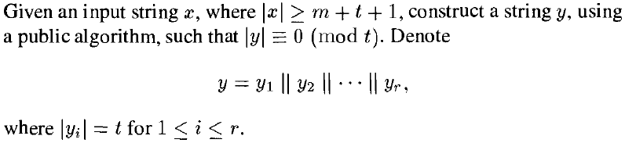

3.1 Iterated Construction – 3 steps
1. Preprocessing step:
padding function
A Requirement:
collision-resistant

Slide 37
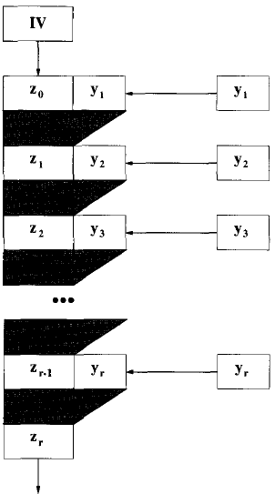
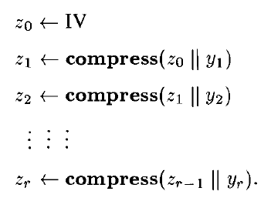
3.1 Iterated Construction – 3 steps
2. Processing step:
length m —
length t
|
length m —

Slide 38
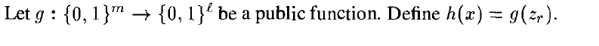
3.1 Iterated Construction – 3 steps
3. Output transformation step: (optional step)
Security?

Slide 39


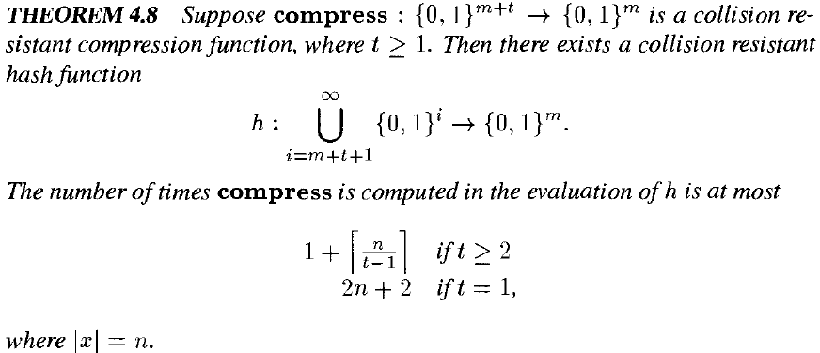
3.2 Merkle-Damgard Construction (MDC)
MDC is a particular method of iterated constructions
where , is
MDC
is
where ,
5.8
Algorithm 5.6
Algorithm 5.7

Slide 40
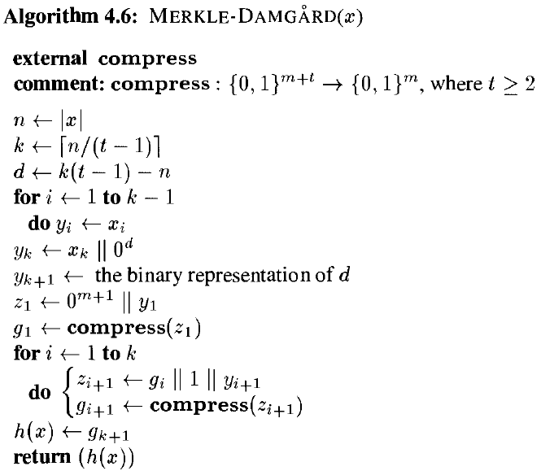
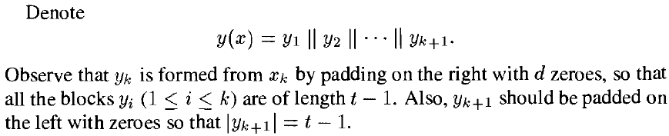
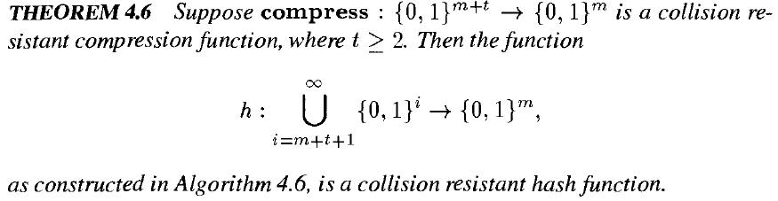
3.2 Merkle-Damgard Construction (skipped)
5.6
Step1
Step2
5.6
5.6

Slide 41
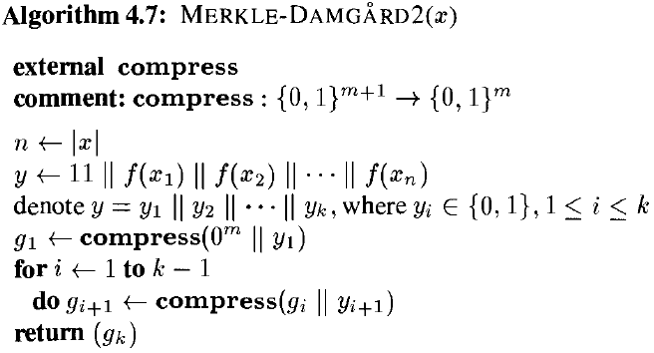
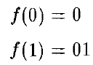
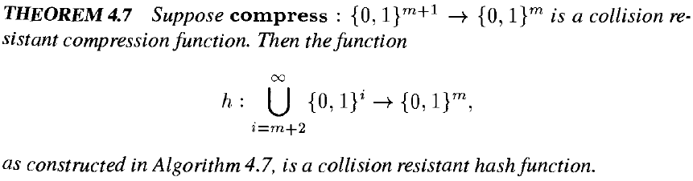
3.2 Merkle-Damgard Construction (skipped)
5.7
Step1
Step2
5.7
5.7

Slide 42
3.3 Some Iterated Hash Functions by MDC
1. MD (Message-Digest) 4, Rivest, 1990, 128-bit output
collisions in the compression function were found in the mid-1990s
2. MD5, Rivest, 1992, 128-bit output
collisions in the compression function were found in the mid-1990s
collisions were found in 2004 at CRYTO 2004 by Wang et al.

Slide 43

Breaks of MD5 and SHA-1
Contributions and Awards:
collisions of MD5 were found in 2004 at CRYTO 2004
collisions of a 58-round reduced SHA-1 were found in 2005
subkey recovery attack on Message Authentication Codes ALPHA-MAC, MD5-MAC and PELICAN was given
the distinguishing attack on HMAC-MD5 was given
Academician of Chinese Academy of Sciences in 2017
Future Science Prize in 2019
……
WANG, Xiaoyun 王小云
Tsinghua University
Shandong University
[1]: X. Wang and H. Yu, “How to Break MD5 and Other Hash Functions”, 2005

Slide 44
3.3 Some Iterated Hash Functions by MDC
1. MD (Message-Digest) 4, Rivest, 1990, 128-bit output
collisions in the compression function were found in the mid-1990s
2. MD5, Rivest, 1992, 128-bit output
collisions in the compression function were found in the mid-1990s
collisions were found in 2004 at CRYTO 2004 by Wang and et al.
3. SHA (SHA-0), NIST, standard, 1993, 160-bit output
collisions were shown to be found in about 2⁶¹ steps, 1998
(efficient than a birthday attack, which requires about 2⁸⁰ steps)
a collision was found by Joux in 2004 at CRYPTO 2004

Slide 45
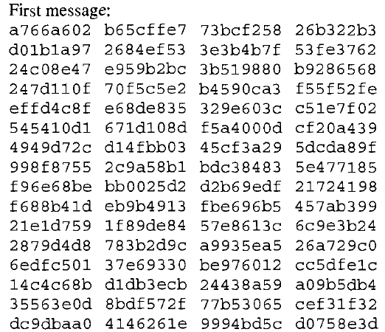
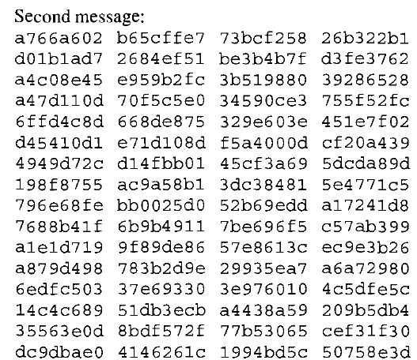
A Collision for SHA-0
A collision for SHA-0 found by Joux and announced at CRYPTO 2004：
The hash value is:

Slide 46
3.3 Some Iterated Hash Functions by MDC
4. SHA-1, NIST, standard, 1995, 160-bit output
collisions of a 58-round reduced SHA-1 were found in 2005 by Wang et al.
In 2006, NIST announced that it might stop to use SHA-1 anymore after 2010.
The first collision was found by Stevens, Bursztein, Karpman, Albertini, and Markov, and announced on Feb. 23, 2017.
(100,000 times faster then a birthday attack that requires about 2⁸⁰ steps)
5. SHA-2, NIST standard in 2002 and 2004
SHA-224, in 2004
SHA-256, SHA-384, SHA-512, in 2002

Slide 47
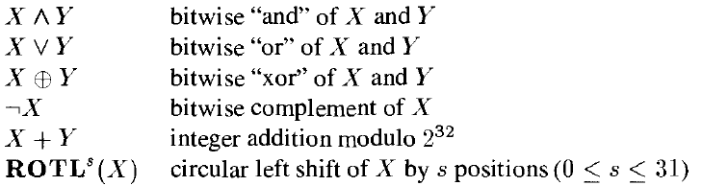
3.4 The Secure Hash Algorithm (SHA-1)
Merkle-Damgard Construction
NIST, standard, 1995
The message digest has 160 bits
Word-oriented operations on bitstrings:
1 word = 32 bits = 8 hexadecimal digits

Slide 48
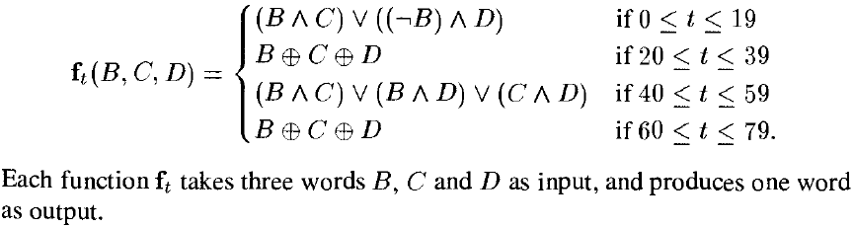
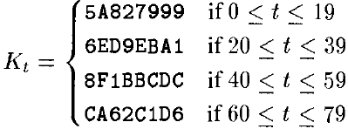
3.4 SHA-1
Define the following (non-linear) functions:
Define the following word constants:

Slide 49
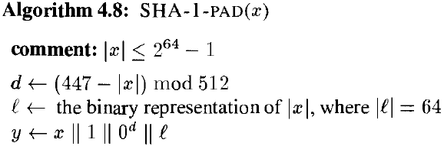

3.4 SHA-1
1. Preprocessing step: padding scheme
1:
The length of the binary representation of x
Each M_{i} has 512 bits (= 16 words)

Slide 50
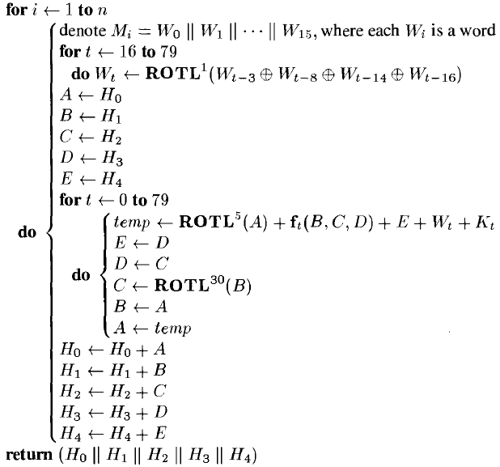
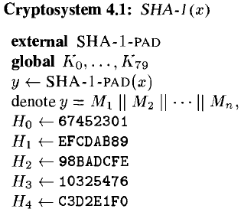
3.4 SHA-1
2. Processing step:
z_{i}=compress(z_{i-1}||M_{i})
compress: {0,1}⁶⁷² →{0,1}¹⁶⁰
1:
z₀=IV=H₀||H₁||H₂||H₃||H₄
The output has 160 bits

Slide 51
Outline
1. Hash Functions and Data Integrity
2. Security of Hash Functions
Security based on three difficult problems
The Random Oracle Model and Algorithms in the ROM
3. Iterated Hash Functions
The Merkle-Damgard Construction & SHA-1
4. The Sponge Construction: SHA-3
5. Message Authentication Codes (MAC)
HMAC & CBC-MAC
Authenticated Encryption
6. Unconditionally Secure MAC

Slide 52
4. The Sponge Construction: SHA-3
SHA-3, NIST standard, 2015
2007, NIST, solicitation
In SHA-3 competition, Keccac, 2012
SHA3-224, SHA3-256, SHA3-384, SHA3-512
SHAKE128, SHAKE256: have variable-length outputs

Slide 53



4.1 The Sponge Construction
By Bertoni, Daemen, Peeters, and Van Assche
Can produce a message digest of arbitrary length
The building block:
f: bijection
width: length b
bitrate: r, efficiency
capacity: c, security

Slide 54
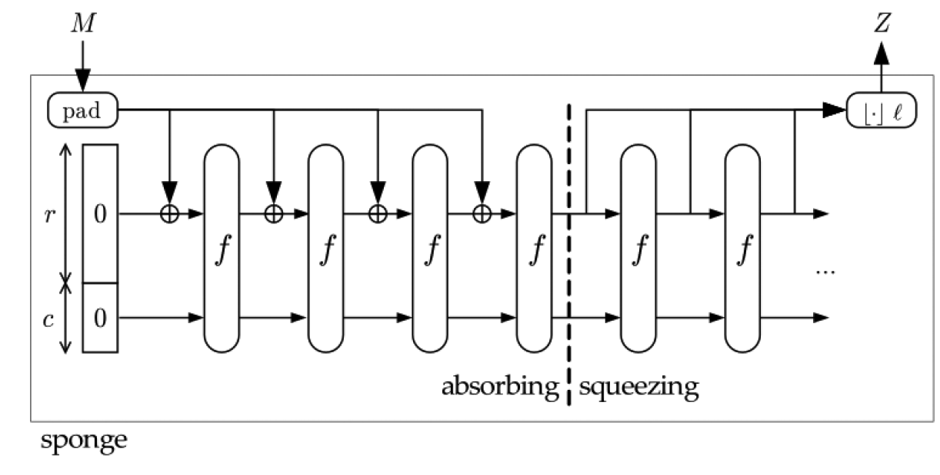
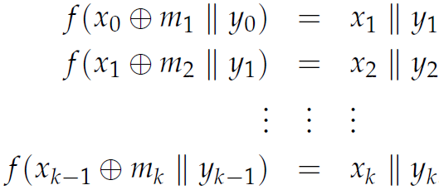



4.1 The Sponge Construction
bitstring with arbitrary length
m1 m2 … mk
x0
y0
state0 state1 state2 … state k
1. The absorbing phase:
state k

Slide 55

4.1 The Sponge Construction
bitstring with arbitrary length
truncating
r bits r bits r bits
x0
y0
state0 state1 state2 … state k
f(x_{k}||y_{k})=x_{k+1}||y_{k+1}
f(x_{k+1}||y_{k+1})=x_{k+2}||y_{k+2}
…….
f(x_{k+j-1}||y_{k+j-1})=x_{k+j}||y_{k+j}
2. The Squeezing phase:
Input: state k, i.e.,
Output: Z with l bits: if l ≤ r, Z is the first l bits of x_{k}
if l > r, 1.apply f to the current state and outputs r bits of x_{k+1},
2.Repeat and Stop when jr <l <(j+1)r.
3.Truncate the output blocks to get l bits as Z

Slide 56

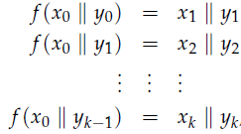
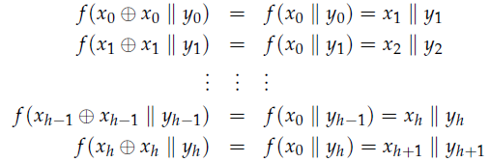
4.2 Security of SHA-3
The security is based on the function f
f is considered as a random oracle that outputs c bits
To find a collision by evaluating f approximately 2^{c/2} times
The security of the sponge function can not be higher than that of a random oracle that outputs c bits
f(x_{k}+x_{k}||y_{k})=f(x₀||y_{k})=f(x₀||y_{h})

Slide 57
4.2 Security of SHA-3
The security is based on the function f
f is considered as a random oracle that outputs c bits
To find a collision by evaluating f approximately 2^{c/2} times
The security of the sponge function can not be higher than that of a random oracle that outputs c bits
The security at the squeezing phase
To find an output collision by evaluating the sponge function approximately 2^{l/2} times (a birthday attack)
Security-level:
min{2^{c/2}, 2^{l/2}} (against a collision attack)

Slide 58
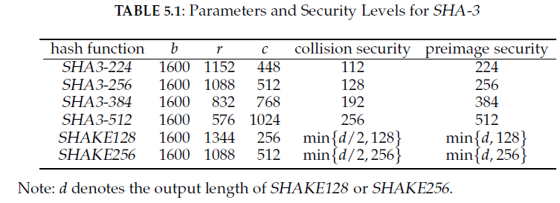
4.2 Security of SHA-3

Slide 59
Outline
1. Hash Functions and Data Integrity
2. Security of Hash Functions
Security based on three difficult problems
The Random Oracle Model and Algorithms in the ROM
3. Iterated Hash Functions
The Merkle-Damgard Construction & SHA-1
4. The Sponge Construction: SHA-3
5. Message Authentication Codes (MAC) and Security
HMAC & CBC-MAC
Authenticated Encryption
6. Unconditionally Secure MAC

Slide 60
5.1 Introduction to MAC
Message Authentication codes (MAC, 消息认证码)
A KEYED hash function, determined by a secrete key K, say y=h_{K}(x); y is the MAC of x under key K.
The pair (x,y) can be transmitted over an insecure channel; the key K must be transmitted over a secure channel and kept secrete.
Objectives
To verify the sender: The message is sent from a TRUE party.
By the secret key
To verify the message: The message is not tampered/changed in transmission/storage.
By the hash value

Slide 61
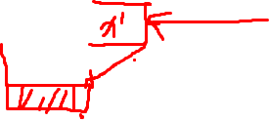
5.1 Introduction to MAC
An Attempt to Construct MAC:
IV = K which is a secret key
→Keyed Hash Function: h_{K}(x)
An Unkeyed iterated hash function
A length extension attack:
|x’| = t

Slide 62




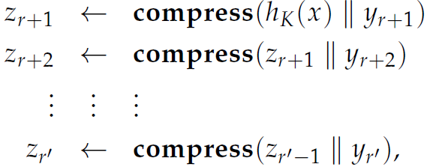


5.1 Introduction to MAC
An Attempt to Construct MAC:
IV = K which is a secret key
Keyed Hash: h_{K}(x)
An attack:
|w| = t,
An Unkeyed iterated hash function
Preprocessing step:

Slide 63


5.1 Introduction to MAC
Security Discussions of MAC:
The adversary: produce a valid pair (x, y) without KEY but with knowledge of other Q valid pairs
A known message attack
A chosen message attack
If the pair (x, y) is valid, and
then (x, y) said to be a forgery.
-forger for a given MAC (under a known/chosen message attack)
If the prob. that the adversary outputs a forgery is at least by at most Q queries.
There exists a known-message (1, 1)-forger for the MAC attempt.

Slide 64


5.1 Introduction to MAC
Security Discussions of MAC:
Two obvious attacks
A key guessing attack: with success prob.
A tag guessing attack: with success prob.

Slide 65
5.1 Introduction to MAC
Classes of MACs
MACs Based on hash functions
Nested MACs → HMAC based on SHA-1
MACs Based on Encryption Schemes
Based on block ciphers: CBC-MAC → CMAC
Based on stream ciphers
Based on PKC

Slide 66



5.2 Nested MACs
A nested MAC builds a MAC algorithm from the composition of two (keyed) hash families.
Given and
Composition where
Roughly speaking, the nested MAC is secure if
1) h_{L}(∙) is secure as a MAC, given a fixed unknown key, and
2) g_{K}(∙) is collision-resistant, given a fixed unknown key.

Slide 67
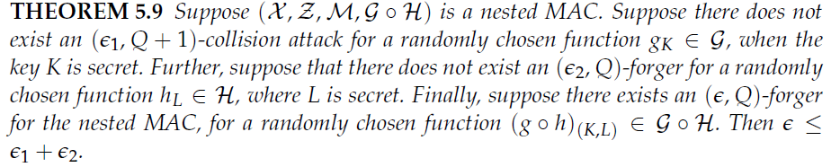
5.2 Nested MACs

Slide 68
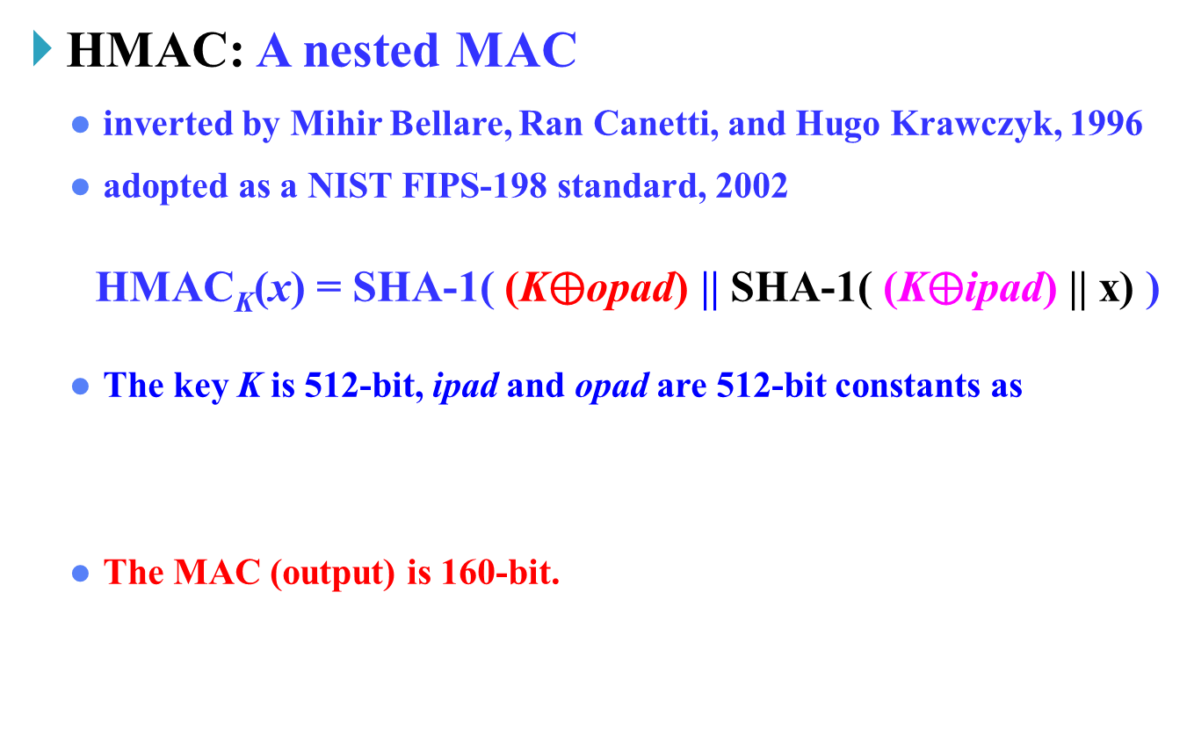

5.2.1 A Nested MAC: HMAC
secure (against forgery)
|
collision-resistant
|
(hexadecimal digits)
KMAC: Keccac-based MAC
A nested MAC based on SHA-3
More secure

Slide 69
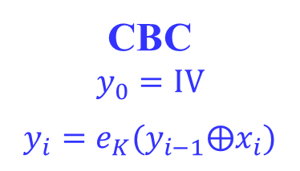
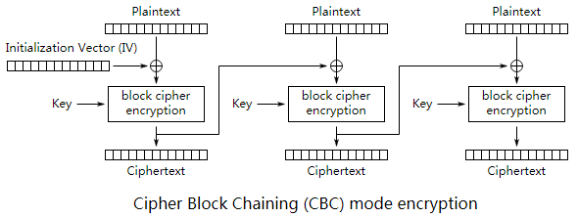
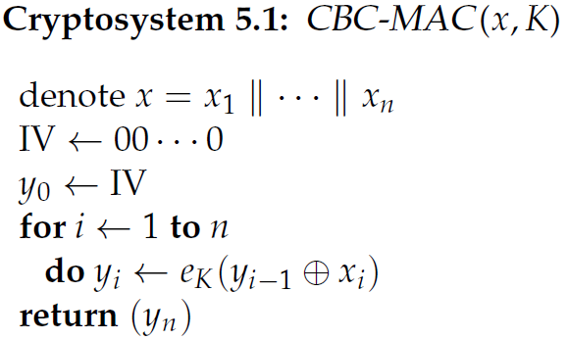
5.3 MACs based on Block Ciphers
CBC-MAC: y=h_{K}(x)
y=y_{n}
The birthday (collision) attack: (1/2, O(2^{t/2}))-forger
Security: based on the randomness of the block cipher
The length of each x_{i} is t.

Slide 70
5.3 MACs based on Block Ciphers
CBC-MAC: y=h_{K}(x)
CMAC: Cipher-based MAC
DAA: DES-CBC-MAC, NIST FIPS-113, 1985
AES-CBC-MAC or 3DES-CBC-MAC

Slide 71
5.4 Authenticated Encryption
To achieve secrecy and data integrity simultaneously
MAC-and-encrypt
For message x, compute z=h_{K1}(x) and y=e_{K2}(x)
send (y, z)
decrypt y to get x, then verify z
MAC-then-encrypt
For message x, compute z=h_{K1}(x), then encrypt y=e_{K2}(x||z)
send y
decrypt y to get x and z, then verify z
Encrypt-then-MAC
For message x, encrypt y=e_{K2}(x), then compute z=h_{K1}(y)
send (y, z)
verify z on y, then decrypt y to get x
preferred due to security and efficiency

Slide 72
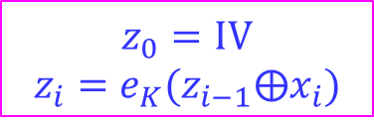
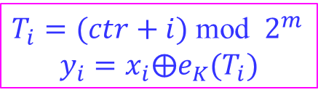


5.4 Authenticated Encryption
CCM-mode MAC: MAC-then-encrypt
combines the use of counter mode (for encryption) with CBC-mode (for authentication).
CCM: Counter with CBC-MAC
CBC mode:
CTR mode:
---Authentication
---Encryption
--first decrypt y
--second generate z_{n} to verify y’

Slide 73
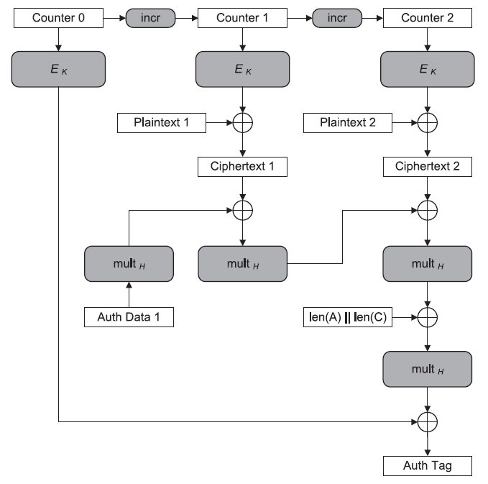
5.4 Authenticated Encryption
GCM-mode MAC:
GCM mode: Galois/Counter mode
Encryption:
Counter mode
AES-128

Slide 74
Outline
1. Hash Functions and Data Integrity
2. Security of Hash Functions
Security based on three difficult problems
The Random Oracle Model and Algorithms in the ROM
3. Iterated Hash Functions
The Merkle-Damgard Construction & SHA-1
4. The Sponge Construction: SHA-3
5. Message Authentication Codes (MAC)
HMAC & CBC-MAC
Authenticated Encryption
6. Unconditionally Secure MAC

Slide 75
6. Unconditionally Secure MACs (skipped)
Unconditional security:
Adversary has infinite computing power
One key is used to produce only one authentication tag.
Known message attack model

Slide 76
Summary
1. Hash Functions and Data Integrity
2. Security of Hash Functions
Security based on three difficult problems
The Random Oracle Model and Algorithms in the ROM
3. Iterated Hash Functions
The Merkle-Damgard Construction & SHA-1
4. The Sponge Construction: SHA-3
5. Message Authentication Codes (MAC)
HMAC & CBC-MAC
Authenticated Encryption
6. Unconditionally Secure MAC

Slide 77
Homework
Problem Set 4: Exercises 5.1, 5.6, 5.7, 5.8, 5.12, 5.13, 5.14, 5.15.

Slide 78

Thank you!
Questions?

Slide 79
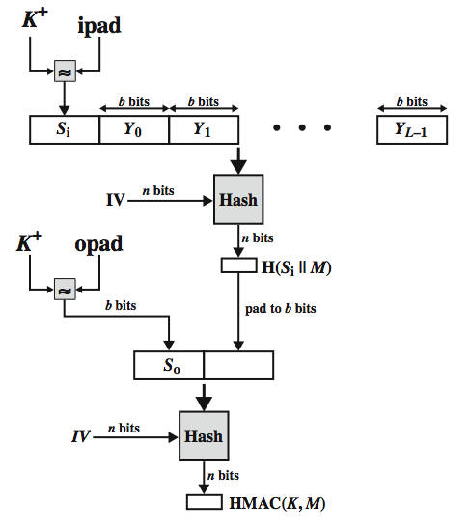
HMAC
Notes:
Stallings Figure 12.5 illustrates the overall operation of HMAC:
HMAC_{K} = Hash[(K⁺ XOR opad) || Hash[(K⁺ XOR ipad) || M)]
where:
K⁺ is K padded with zeros on the left so that the result is b bits in length
ipad is a pad value of 36 hex repeated to fill block
opad is a pad value of 5C hex repeated to fill block
M is the message input to HMAC (including the padding specified in the embedded hash function)
Note that the XOR with ipad results in flipping one-half of the bits of K. Similarly, the XOR with opad results in flipping one-half of the bits of K, but a different set of bits. In effect, pseudorandomly generated two keys from K. HMAC should execute in approximately the same time as the embedded hash function for long messages. HMAC adds three executions of the hash compression function (for Si, So, and the block produced from the inner hash). A more efficient implementation is possible by precomputing the internal hash function on (K⁺ XOR opad) and (K⁺ XOR ipad) and inserting the results into the hash processing at start & end. With this implementation, only one additional instance of the compression function is added to the processing normally produced by the hash function. This is especially worthwhile if most of the messages for which a MAC is computed are short.

